Slide 1
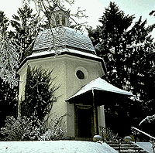
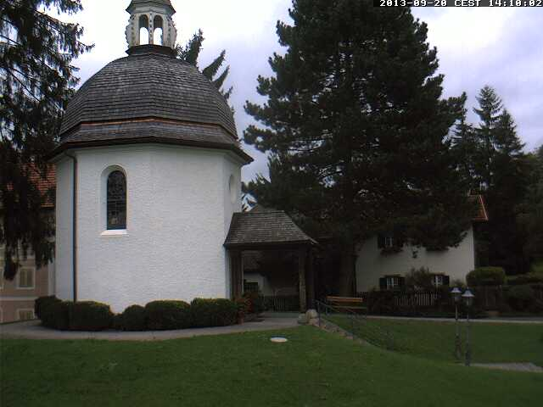
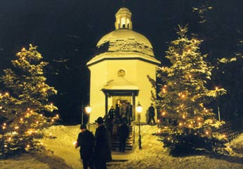
The Origin of Silent Night honored today in Austria at St. Nicola, The Silent Night Chapel

Slide 2
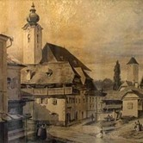
http://home.snu.edu/~hculbert/silent.htm The Story of how it was written http://www.stillenacht.info/en/ Former Church St. Nicola in Oberndorf bei Salzburg, Austria
In 1818, a roving band of actors was performing in towns throughout the Austrian Alps. On December 23 they arrived at Oberndorf, a village near Salzburg where they were to re-enact the story of Christ's birth in the small Church of St. Nicholas. Unfortunately, the St. Nicholas' church organ wasn't working and would not be repaired before Christmas.

Slide 3
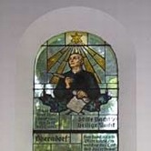
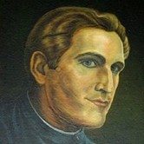
Because the church organ was out of commission, the actors presented their Christmas drama in a private home. That Christmas presentation of the events in the first chapters of Matthew and Luke inspired assistant pastor
Josef Mohr.

Slide 4
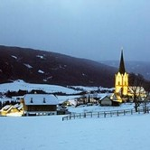
Instead of walking straight to his house that night, Mohr took a longer way home. The longer path took him up over a hill
overlooking a peaceful snow-
covered village.
Mohr gazed down at the glowing
Christmas-card like scene. His
thoughts about the Christmas
play he had just seen made him
remember a poem he had written a couple of years before, about the night when angels announced the birth of the long-awaited Messiah.

Slide 5
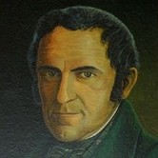
Mohr decided those words might make a good carol for his congregation the following evening at their Christmas eve service. But he didn't have any music to which that poem could be sung. So, the next day Mohr went to see the church organist, Franz Xaver Gruber.
Gruber only had a few hours
to come up with a melody
which could be sung with a guitar.
However, by that evening, Gruber had managed to compose a musical setting for the poem. They now had a Christmas carol that could be sung without that organ.

Slide 6
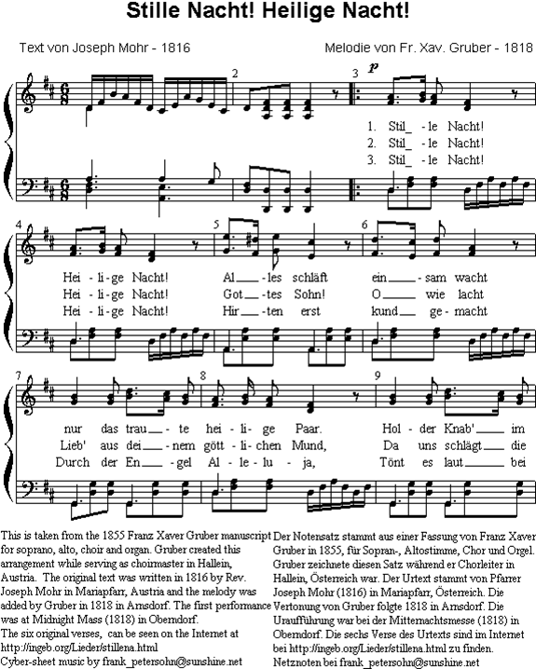
On Christmas Eve, the little Oberndorf congregation heard Gruber and Mohr sing their new composition to the accompaniment of Gruber's guitar.
Weeks later, well-known organ builder Karl Mauracher arrived in Oberndorf to fix the organ in St. Nicholas church. When Mauracher finished, he stepped back to let Gruber test the instrument. When Gruber sat down, his fingers began playing the simple melody he had written for Mohr's Christmas poem. Deeply impressed, Mauracher took copies of the music and words of "Silent Night" back to his own Alpine village, Kapfing.

Slide 7
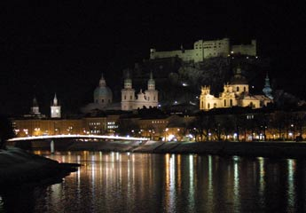
There, two well-known families of singers — the Rainers and the Strassers — heard it. Captivated by "Silent Night," both groups put the new song into their Christmas season repertoire. The Strasser sisters spread
the carol across
northern Europe.
In 1834, they performed
"Silent Night" for King
Frederick William IV of Prussia,
and he then ordered his cathedral choir to sing it every Christmas eve.

Slide 8
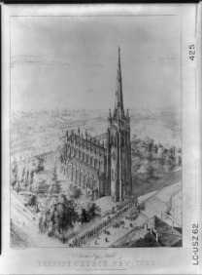
Twenty years after "Silent Night"
was written, the Rainers brought the
song to the United States, singing it
(in German) outside
New York City's Trinity Church.
In 1863, nearly fifty years
after being first sung in German,
"Silent Night" was translated into
English (by either Jane Campbell or John Young). Eight years later, that English version made its way into print in Charles Hutchins' Sunday School Hymnal.
Today the words of "Silent Night" are sung in
more than 300 different languages around the world.

Slide 9
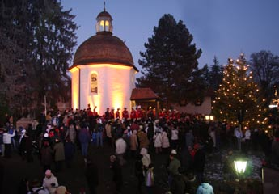
let us sing Silent Night together now.

